Slide 1

HR Analytics Employee Retention

Slide 2

Mentor : MR.Shubham kabre
Project Members :
Chinmay S M
Shantanu Ajit Khamkar
Atharva Sanjay Sangar
Shubham Gunaji Nagpure
Shruthi Sudhakaran Thandan
Aditee Samir Dhatkar

Slide 3
Agenda:
Introduction & Problem Statement
Business Objective
KPI’s
Problems which we have faced during this project
Conclusion

Slide 4
Introduction:
Human Resource analytics (HR Analytics) is defined as the area in the field of analytics that deals with people analysis and applying analytical process to the human capital within the organization to improve employee performance and improving employee retention.
Problem Statement:
Average Attrition rate for all Departments
Average Hourly rate of Male Research Scientist
Attrition rate Vs Monthly income stats
Average working years for each Department
Job Role Vs Work life balance
Attrition rate Vs Year since last promotion relation

Slide 5
Business Objective:
Aim of this project is to study the Employee Retention and visualize it. Based on the visualizations and analysis, HRs will get insights and can make strategies to retain the employees.
To identify how retention strategy reduce turnover?
To know how to retain employee?
To verify the satisfaction level of employee in the organization.

Slide 6
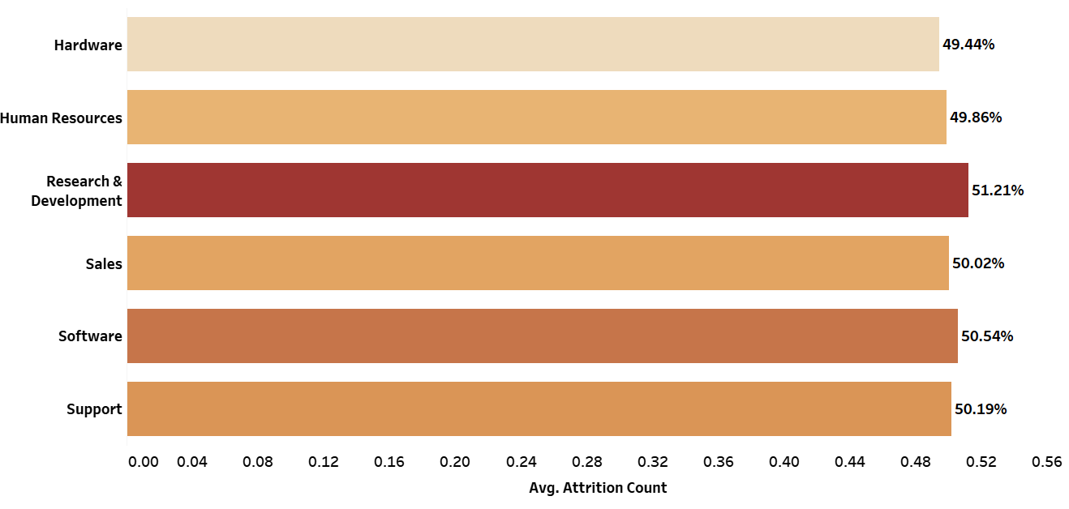
Average Attrition rate for all Departments
This KPI is to find out the relationship between each department and its attrition rate.
Tableau

Slide 7
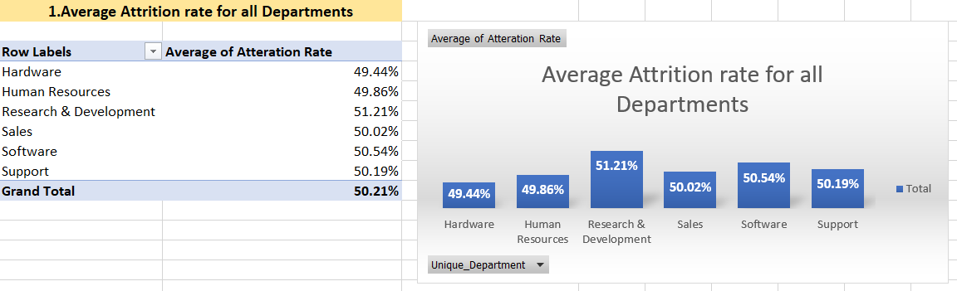
Excel
We can clearly say that department wise attrition rate of employees is almost 50%. That means attrition rate of employees does not depends on department. So whichever department it is, 50% employees are leaving the company.
From this calculations and visualizations we concluded that we have to make strong strategies to minimize attrition rate and improve our company’s Employee retention so that we can balance the company’s growth and right talent.

Slide 8
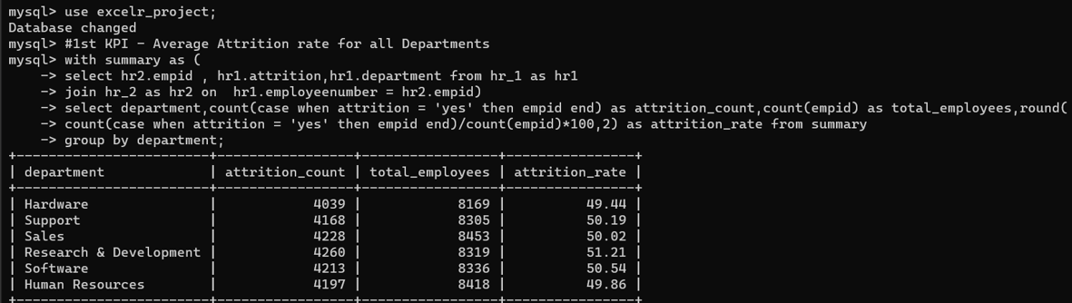
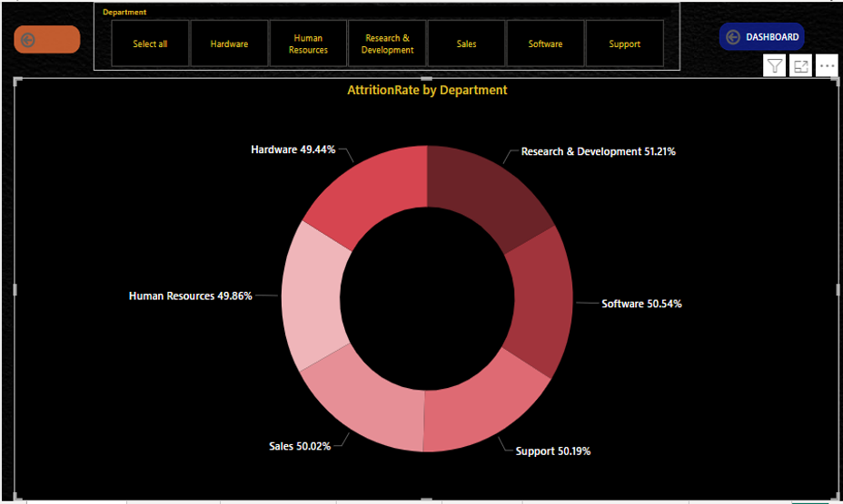
Effects of Attrition :
Low productivity - Notice Period, Knowledge Transfer.
Loss of knowledge, expertise.
Loss of picked up business relationships.
Negative impact on other team members.
Benefit to competitor.
Excess Work Load.
SQL
Power BI

Slide 9
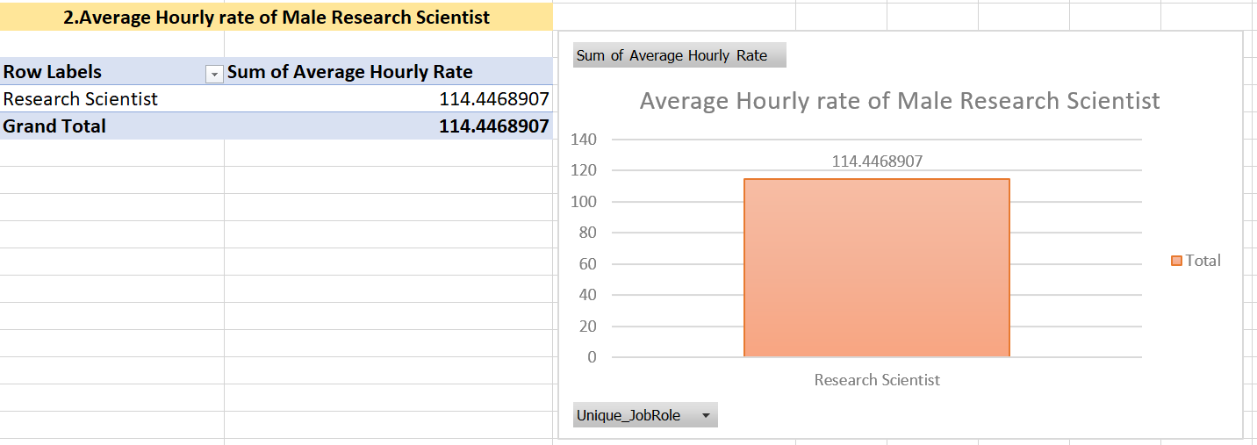
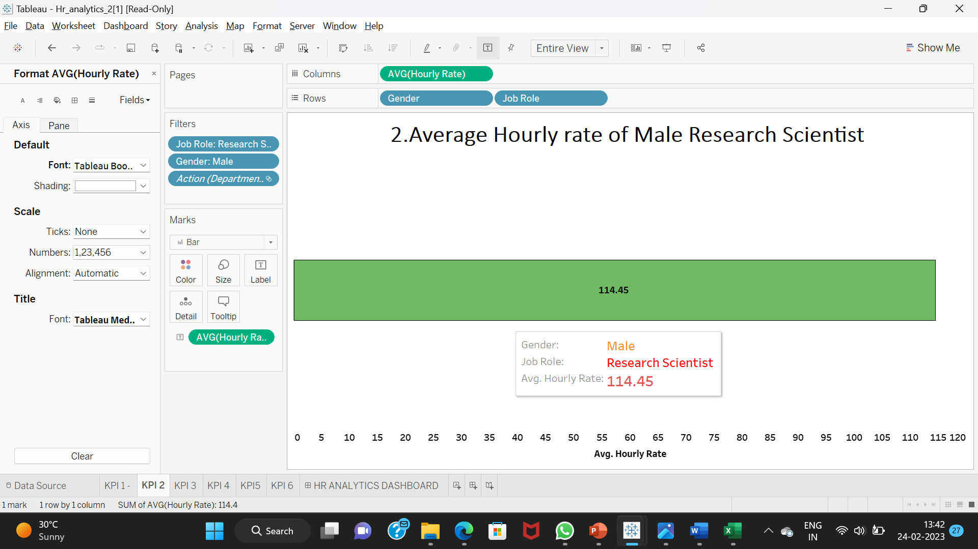
Average Hourly rate of Male Research Scientist
Excel
Many job roles are there in HR dataset like Developer, Research director, Sales executive, Human resources, etc. This KPI is to find out the average hourly rate of male research scientists.
Tableau

Slide 10
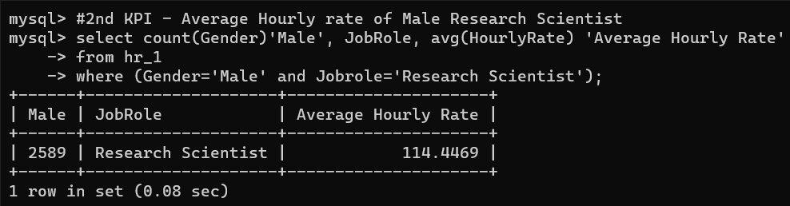
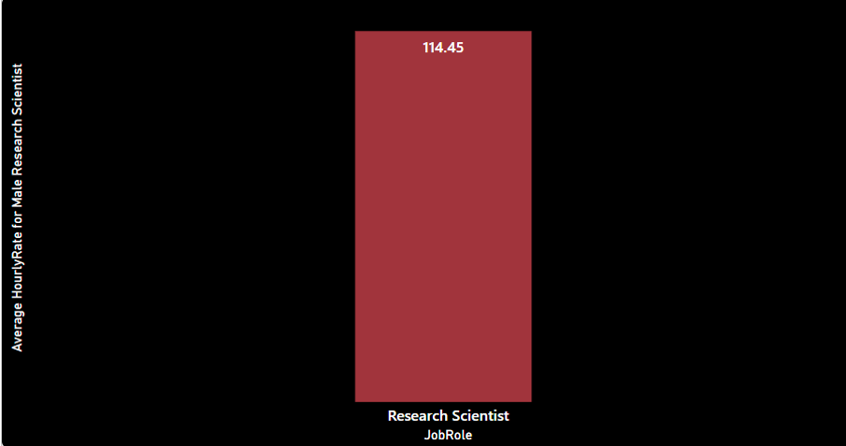
SQL
we can say that average hourly rate of male research scientist is rupees 114 per hour.
Power BI

Slide 11
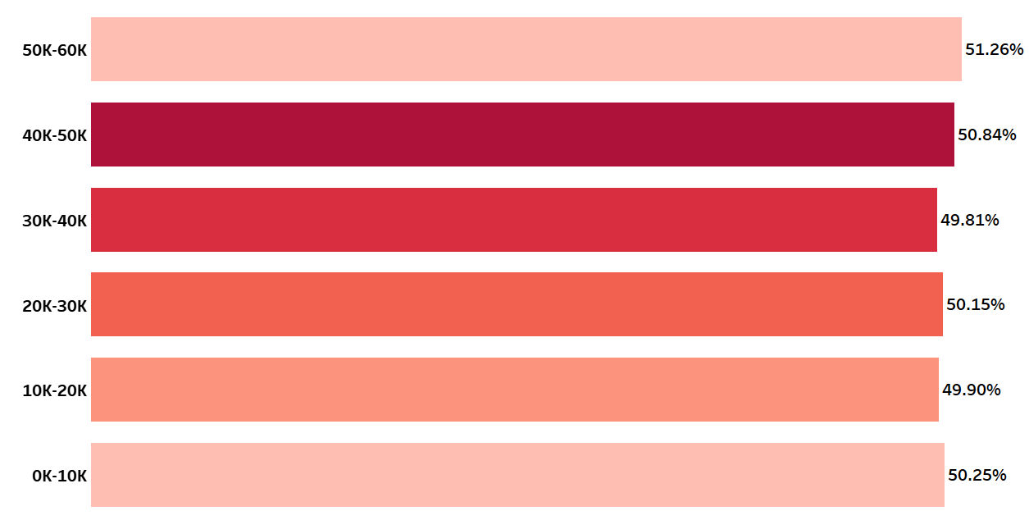
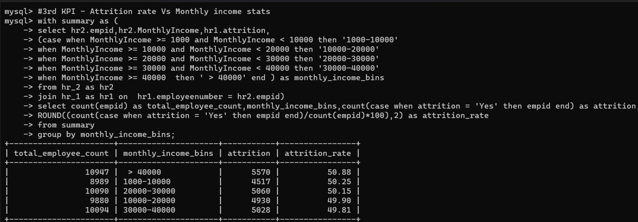
Attrition rate Vs Monthly income stats
This KPI is to find out the relation between monthly income and attrition rate.
Tableau
SQL

Slide 12
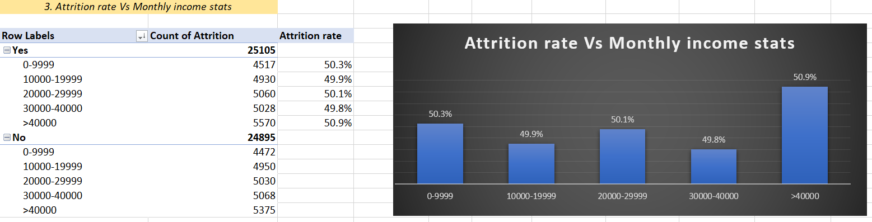
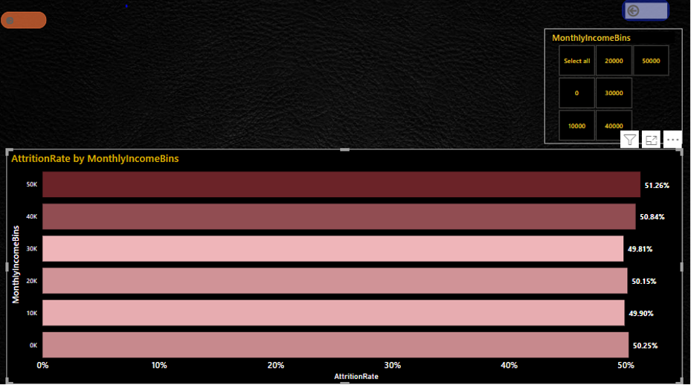
Excel
From this we can conclude that attrition rate is not dependent on salary, as Attrition rate for all monthly income bins is nearly 50%.
Power BI

Slide 13
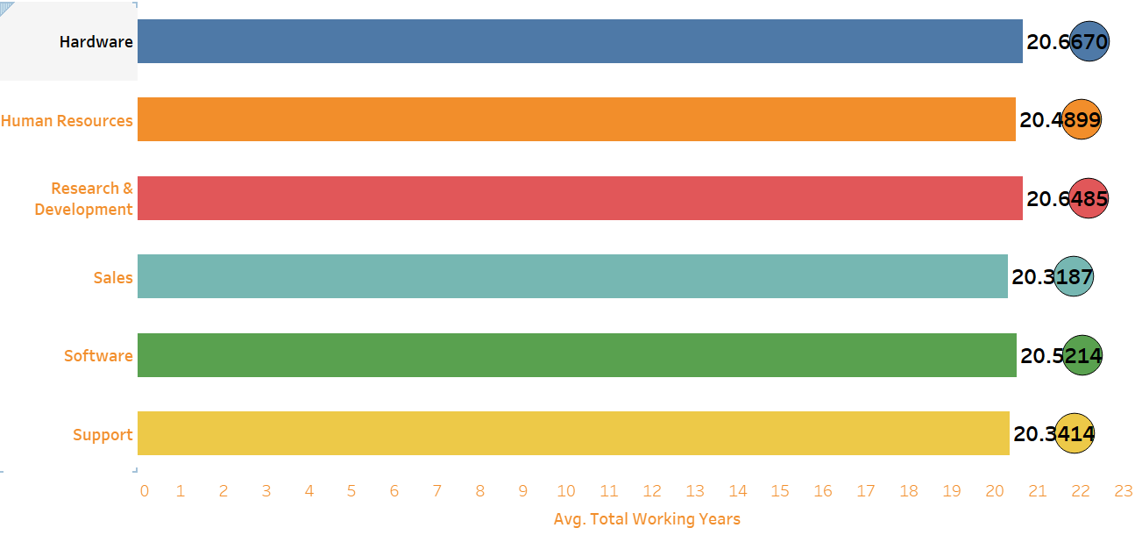
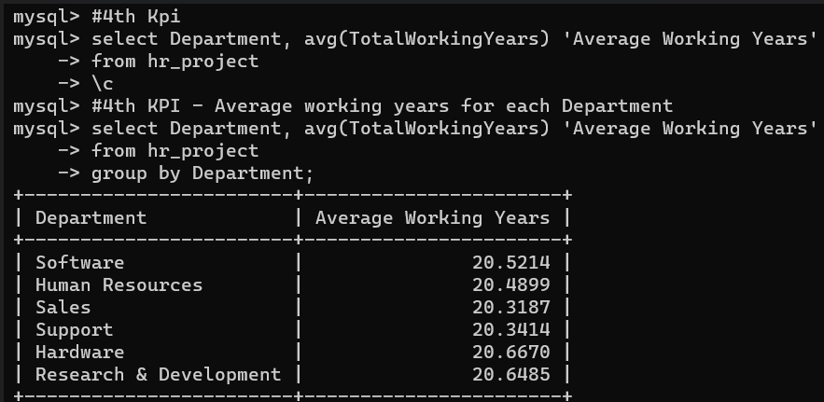
Average working years for each Department
Tableau
This KPI is to find out average working years of each department.
SQL

Slide 14
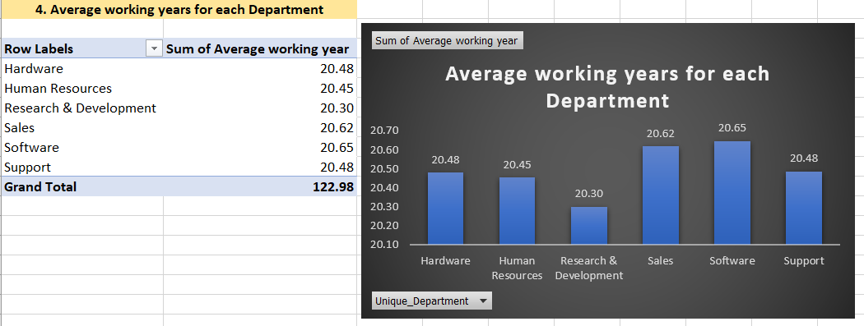
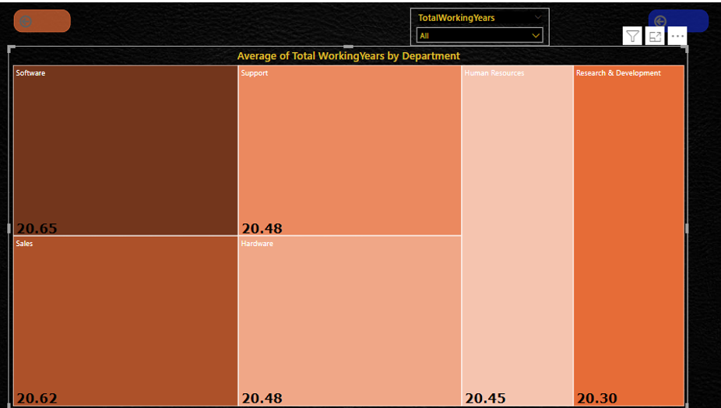
From this graph, we can see that the average working years in software department is high as compared to the rest of the departments.
Excel
From this analysis, we can conclude that average working years is approximately 20 for all departments.
Power BI

Slide 15
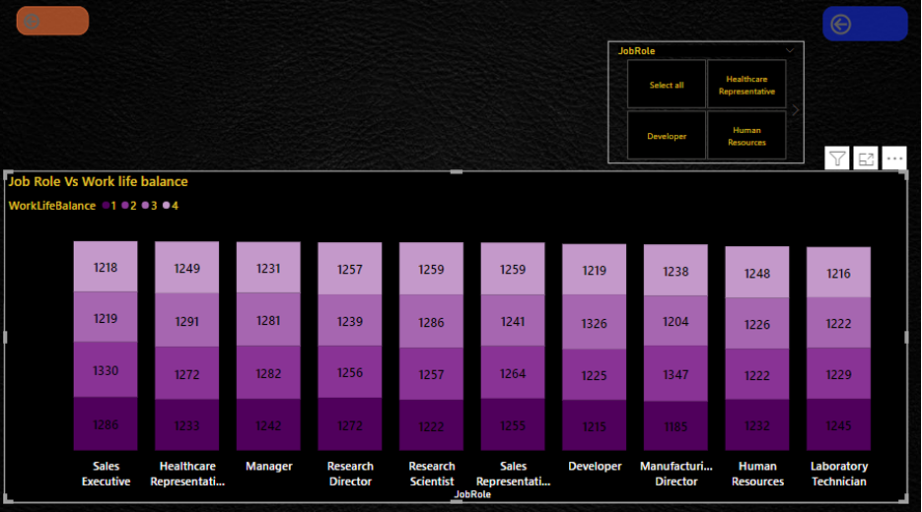
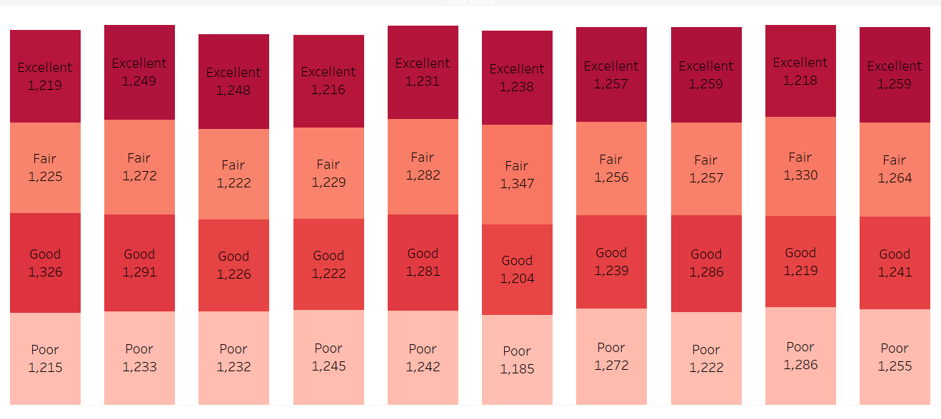
Job Role Vs Work life balance
This KPI is to find the relation between job role of employees and their work life balance.
Power BI
Tableau

Slide 16
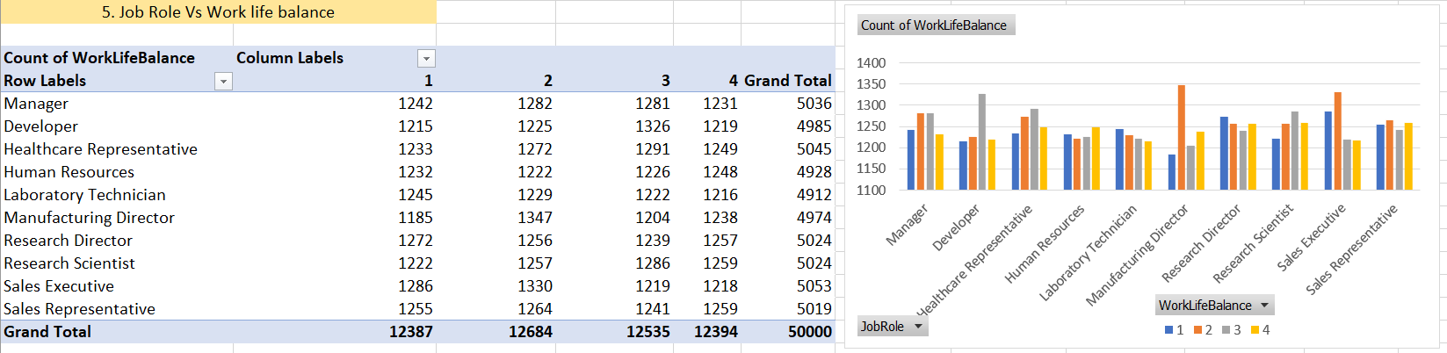
Note :
1 – Poor.
2 – Fair.
3 – Good.
4 – Excellent.
Excel
From this analysis, we can conclude that,
For Manager Job Role the Work Life Balance is Fair.
For Developer Job Role the Work Life Balance is Good.
For Healthcare Representative Job Role the Work Life Balance is Good.
For Human Resources Job Role the Work Life Balance is Excellent.
For Laboratory Technician Job Role the Work Life Balance is Poor.
For Manufacturing Director Job Role the Work Life Balance is Fair.
For Research Director Job Role the Work Life Balance is Poor.
For Research Scientist Job Role the Work Life Balance is Good.
For Sales Executive Job Role the Work Life Balance is Fair.
For Sales Representative Job Role the Work Life Balance is Fair.

Slide 17
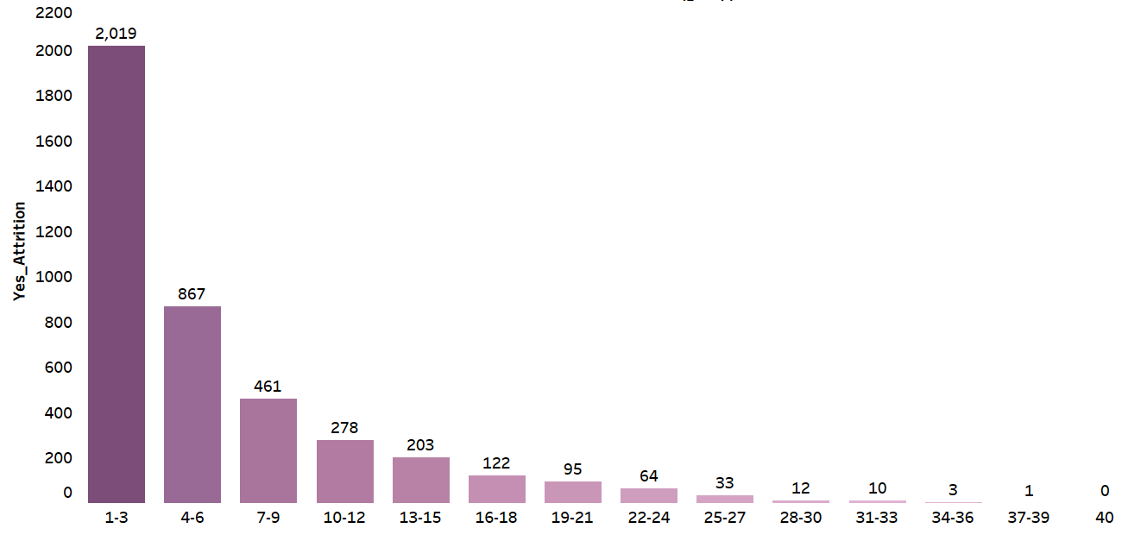
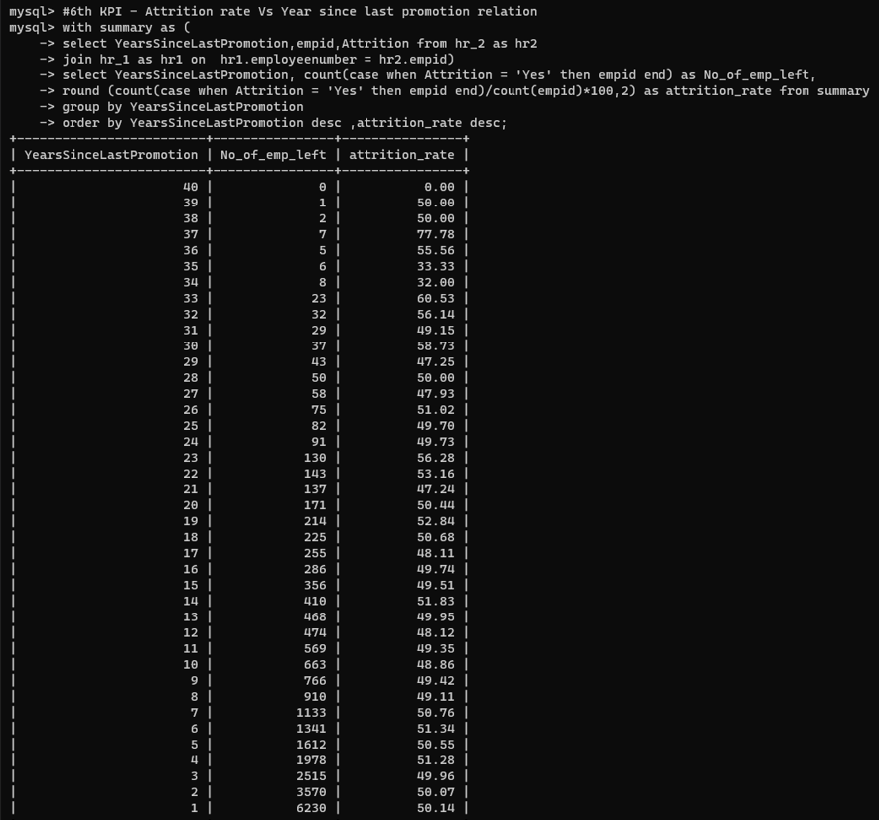
Attrition rate Vs Year since last promotion relation
Tableau
This KPI is to find out the relation between the Attrition Rate of employees and Years Since Last Promotion.
SQL

Slide 18
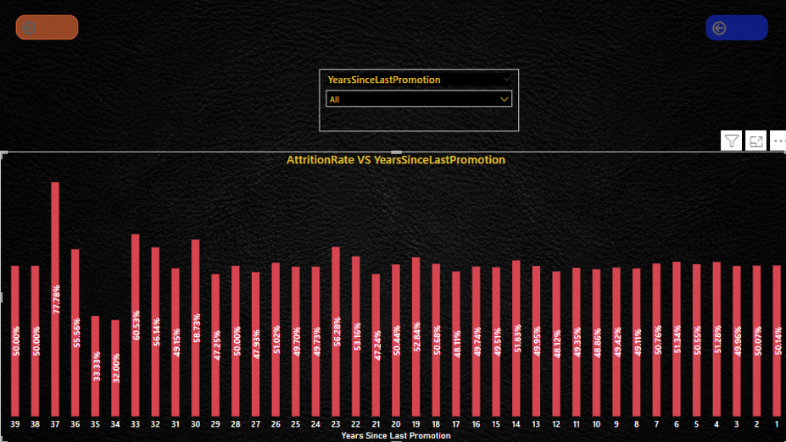
Power BI
From this analysis we can conclude that, highest Attrition Rate is 77% for 37 years since last promotion,and the lowest Attrition rate is 32% for 34 years since last promotion.

Slide 19
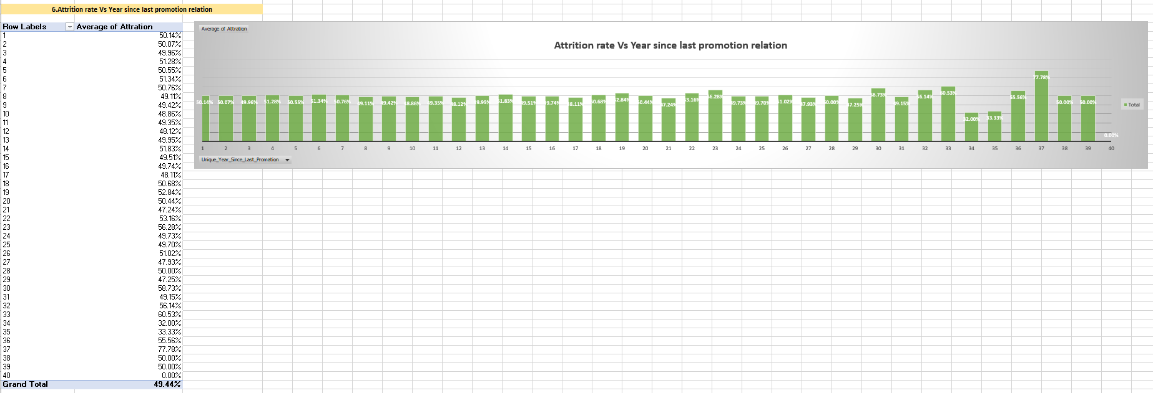
Excel
By this graph we can say that, years since last promotion do not have any impact on Attrition, as last year promoted employee's Attrition Rate is approximately 50%.

Slide 20
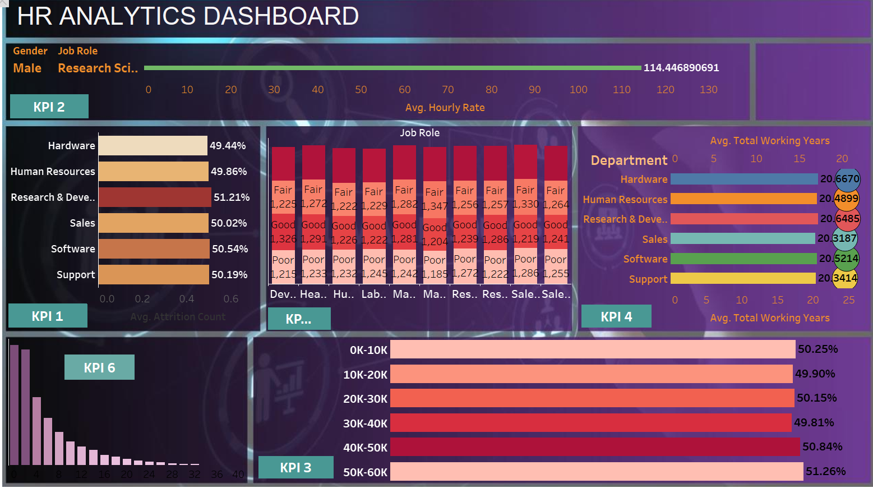

Slide 21


Conclusion :
The process of retention is not an easy task.
There are so many tactics and strategies used by the organization to retain the employee.
The basic purpose of this strategies is to increase the employee satisfaction, boost employee moral and hence achieve employee retention.
Relationships between employee and management must be improved.
To find out what motivates an employee to continue to work in an organization.
.

Slide 22
Thank you..

